Slide 1




Mitron Bank Credit Card Usage: Pilot Project
- Krupal Patel

Slide 2

Problem Statement
Mitron Bank is a legacy financial institution headquartered in Hyderabad. They want to introduce a new line of credit cards, aiming to broaden its product offerings and reach in the financial market.
AtliQ Data Services discovered this opportunity via an internal source and presented a proposal to undertake the project with Mitron Bank. However, Mitron Bank's Strategy Director suggested conducting a pilot project using sample data before committing to the entire endeavor.
Consequently, AtliQ Data Services was tasked with analyzing a sample dataset encompassing 4000 customers in five cities, detailing their online spending habits and other relevant information.

Slide 3
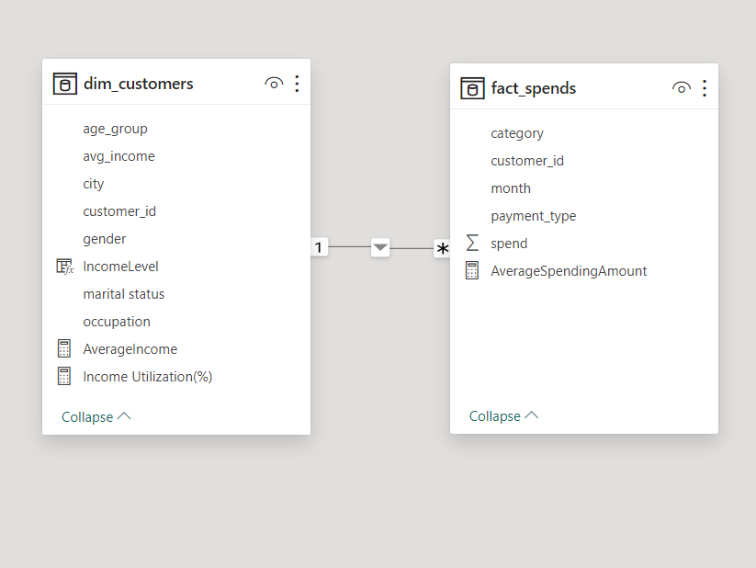
Data Set for the Analysis

Slide 4
Let’s Understand Mitron Bank’s Customer
Total Customers : 4000
Males : 2597
Females : 1403
Married: 78%
Single: 22%
Average Income of Customers : 51.66K

Slide 5
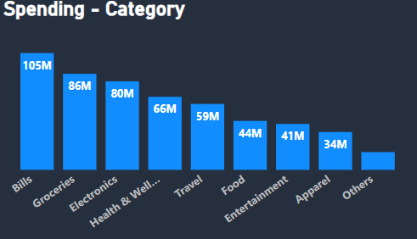
In which category people spend their money the most ?
Insight:
It is clear that most of the spending of our customer goes to paying bills and buying groceries and electronics.
Suggestion: Create targeted rewards programs for bills, groceries, and electronics spending to encourage customers to use the bank's credit card, boosting card usage.

Slide 6
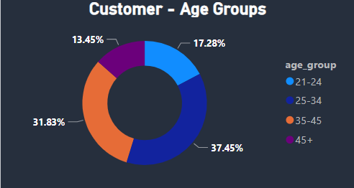
What age group makes the most significant spending contributions?
Insight:
Customers between 25 to 45 are our target customers because they contribute more than 75% of total spendings across the bank.
Suggestion:
Customize financial products, like credit cards or loans, to align with the unique requirements and preferences of individuals between the ages of 25 and 45.
Focus marketing initiatives on individuals aged 25 to 45 to draw in and gain more customers from this age bracket

Slide 7
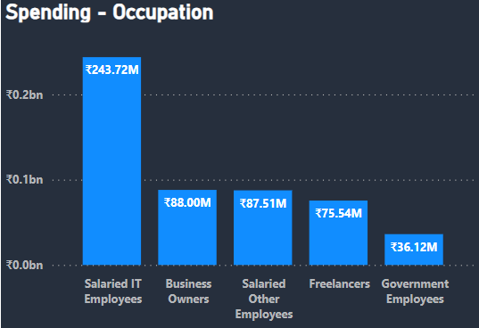
Which employees are the primary contributors to major expenditures?
Insight:
Salaried IT workers play a significant role in contributing to the total spending, holding the top position and contributing 243.72 million Rupees.
Suggestion: Bank can establish collaborations with IT firms or providers of technology-related services. Providing joint promotions or exclusive offers to salaried IT professionals can incentivize them to select the bank for their financial requirements.

Slide 8
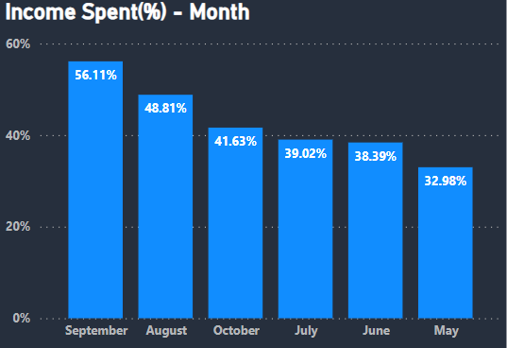
Which Month has the highest Income Spent(%)?
Income Spent(%) = (Total Spend / Total Income)*100
Insight:
September and august is the months where most people spend the money and may is accounted for lowest money spend.
Suggestion:
Bank might contemplate providing elevated credit limits or temporary expansions specifically in September and August, acknowledging the increased financial requirements of customers at that time.
To encourage card usage during May, Bank could introduce incentives, such as bonus rewards or cashback offers, during this period.

Slide 9
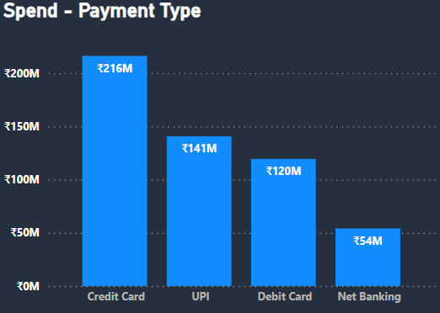
What is the most favourite payment method for our customers?
Insight:
The visual illustrates that the majority of overall expenditures are allocated to credit cards, followed by UPI.
In India, UPI is widely favored for its convenient, cardless transactions and its affordability, widely embraced by merchants.
Suggestion:
Collaborate with top merchants to provide exclusive benefits for Mitron bank credit card users, such as a 10% discount at a popular grocery mall. This partnership aligns with customer spending preferences, encouraging increased credit card usage.

Slide 10

Let’s Take a Look At The PowerBi Dashboard

Slide 11
Thank you Everyone for your time
Thank you
Dhaval Patel & Hemanand Vadivel
for this amazing project.

